Slide 1
Finding the best option of an apartment in Bucharest
Dolganiuc Ana

Slide 2
Introduction

Slide 3
Background
Bucharest is a big city with plenty of neighborhoods and options for renting or buying real estate. For a businessman,or a simple person who wants to buy an apartment the variety of options can be overwhelming. I'm part of the DataScientists group of a Real Estate agency and I was requested to find the best apartment in Bucharest, Romania and to fit the criteria set by the client.
His main requests are:
to have 1 or 2 rooms
to be in the range of the average price
to be near the central zone
to be near the subway
to be in the area with most venues
to have the price between 55.000 and 90.000

Slide 4
Problem
What is the best option of an apartment for a couple in Bucharest in 2021?

Slide 5
Data acquisition and cleaning

Slide 6
Data sources
I used the dataset about the Real Estate found on kaggle , and the Foursquare API
The Foursquare location data- I will use the Foursquare location data to fill all the client's requested criteria about how the zone should be like
Real Estate csv- I will use a Real Estate csv found on kaggle with the prices and the locations of the apartments(from april 2021), which will give me the opportunity to search for an apartment that will suit my client the best The columns of the csv are: location_area, price, rooms_count and subway_distance

Slide 7
Data cleaning
After downloading the csv into the notebook, I started filtering the data. First of all I’ve dropped all the unnecessary columns, changed the row values with more significant ones, displayed only the apartments (because the data set contained other types of real estate), and replaced some location names that didn’t match with the geocoder library. In addition, I dropped some columns that contained missing values which were insignificant in the whole process. Ultimately, I checked the data type of every column and the number of rows and columns necessary to continue the process.

Slide 8
Feature selection
After cleaning the data frame, I began the process of selecting the apartments by the criteria set by the client.
Firstly, I looked for the areas closer to the subway, with a distance with less than 900 meters. Then I selected the apartments that had 1 or 2 rooms
Secondly, I found the latitude and longitude of every neighborhood using the geopy and geocode libraries. After that I used the folium library to locate the central areas, and found out that there were 13 areas of this kind.

Slide 9
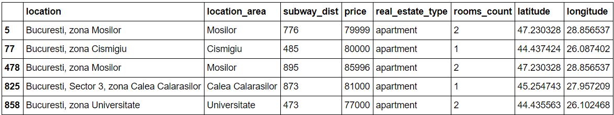
After Data cleaning and Feature selection my Data Frame looked like this:

Slide 10
Exploratory Data Analysis

Slide 11
Displaying the target variables
At this stage I used the Foursquare API to identify the venues within 500 m from the neighborhood and set a limit of not more than 100 venues per borough.

Slide 12
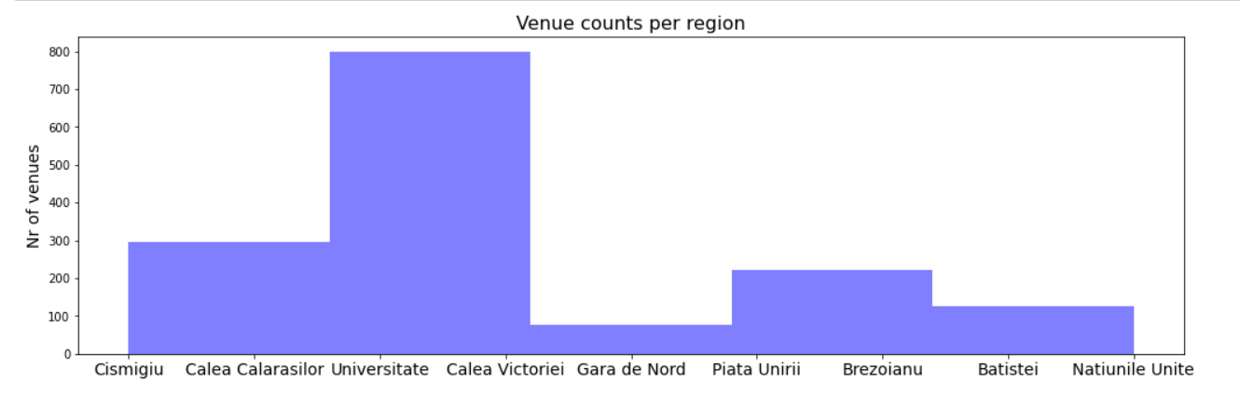
Relationship between venues and neighborhoods
Here I identified which neighborhood had the biggest number of venues and found out that the most popular neighborhood was “Universitate” with around 800 venues

Slide 13
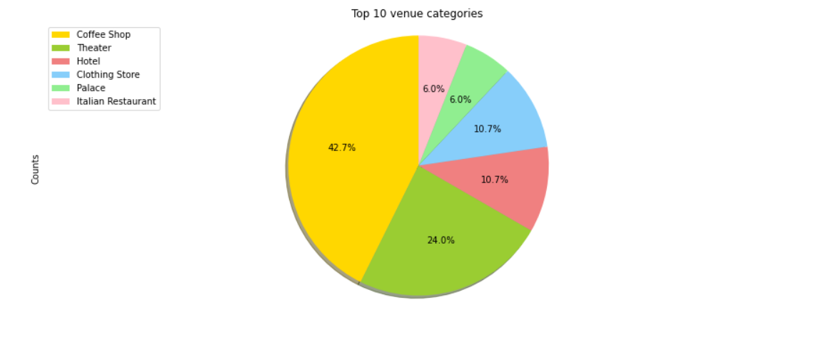
Relationship between venue category and neighborhood
I decided to see top 10 most popular venues in our target area- Universitate, and as displayed on the pie chart, the top most important venue categories are : Coffee Shops(42,7%), Theaters, Hotels, Clothing Stores, Palaces and Italian Restaurants

Slide 14
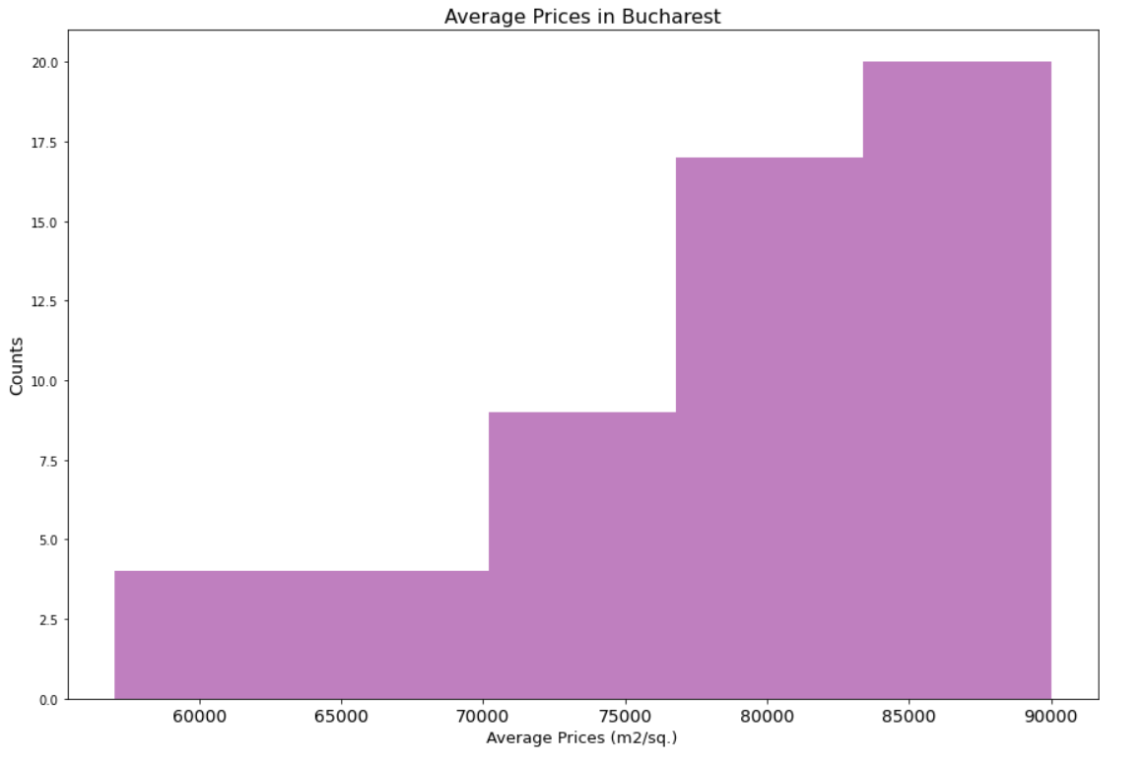
Relationship between price and neighborhood
First of all, I set the price to be in the specific range between 55.000 and 90.000 ron per m² , after that I represented the average prices in all the neighborhoods from Bucharest with a histogram graph

Slide 15
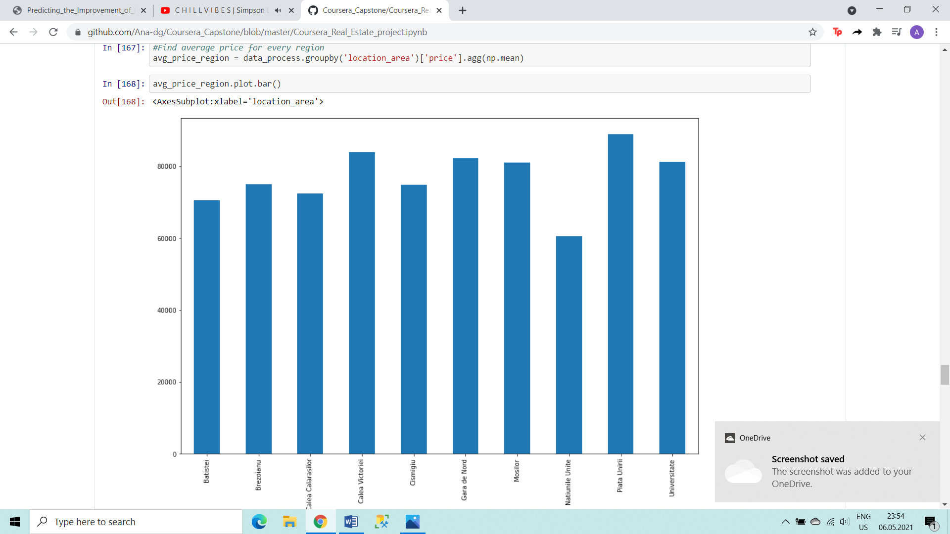
After that I visualized the price range for our specific area with a bar chart and found out that the average prices in our selected area is around 80.000 ron per m²

Slide 16
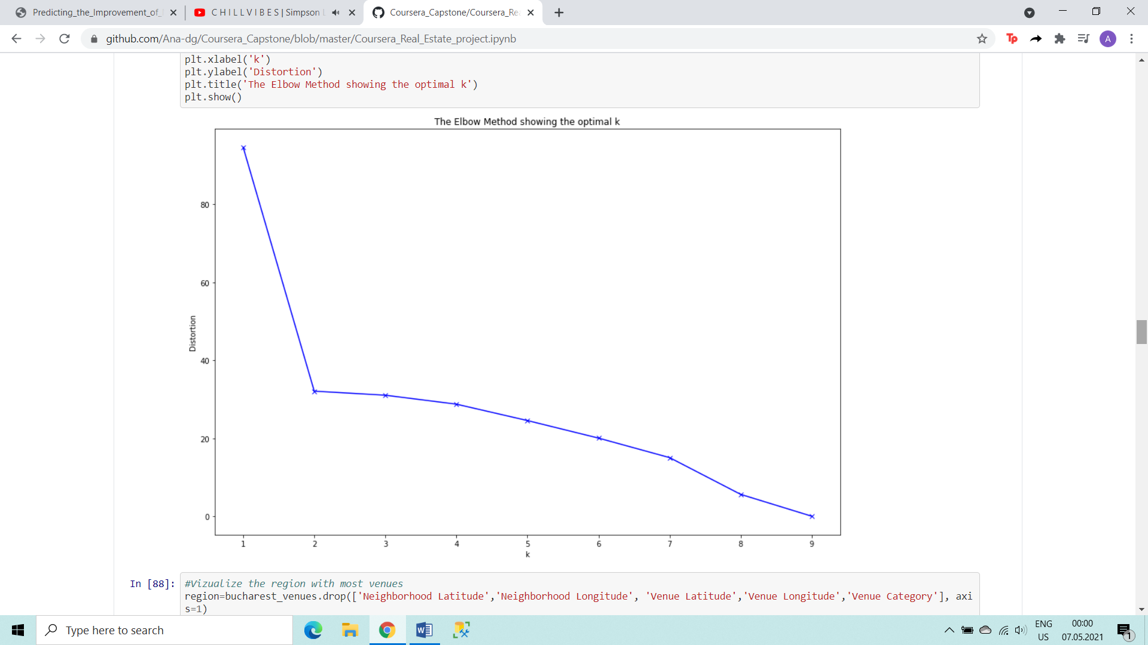
Clustering
In this situation the best predictive model would be a clustering one, more precisely a K means clustering model. It is essential to use it in order to see the top 10 most popular venues in our area. For k means I used k=2 which was the best option gave by the Elbow method function.

Slide 17
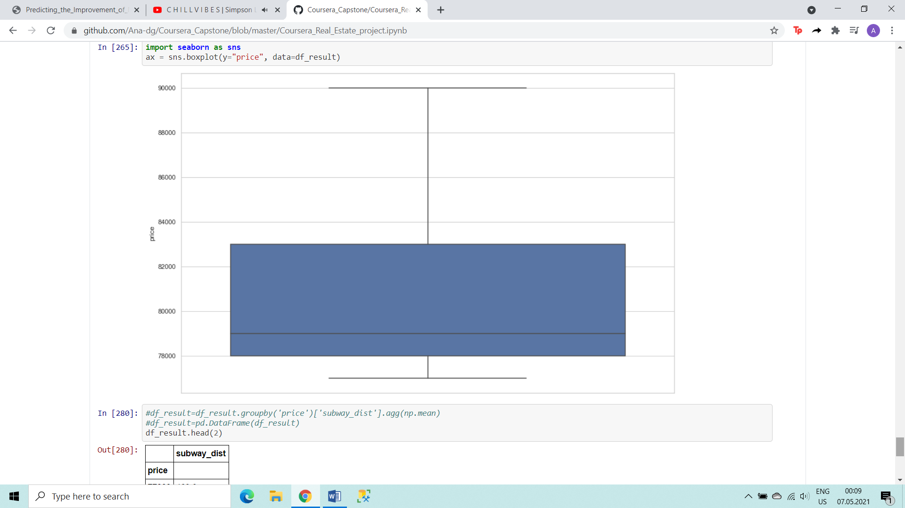
Finding the best price
After all the analysis I visualized the filtered data frame with the prices and found out that the lowest price after all the set criteria would be 77.000 and the biggest would be 90.000 for a 2 rooms apartment in the Universitate area

Slide 18
Conclusions
As seen in the analysis there are a variety of apartments on sale in Bucharest(9974 more exactly). With the great multitude of neighbourhoods, it takes time to analyze which variant would be the best. Moreover the analysis depends on the customer's needs, whatever he is looking for a family-friendly zone or for a fun zone for the youth.
I used the K-means algorithm as part of this clustering study. When I tested the Elbow method, I set the optimum k value to 2. For more detailed and accurate guidance, the data set can be expanded and the features can be changed based on the custormer's need.
I also performed data analysis through this information and ploted/clustered the most important insights of this project
I ended the study by determining the best option of a neighborhood according to price, number of rooms, distance from subways and top venues in the zone
As a result, this kind of data analysis would fit any type of customer: from business people who are looking for offices to families that decided to buy real estate
Not only for investors but also city managers can manage the city more regularly by using similar data analysis types or platforms.

